Slide 1
PROJECT NAME-CAUSE OF DEATH
BY-NEETU BAM
BATCH NO-DS0622

Slide 2
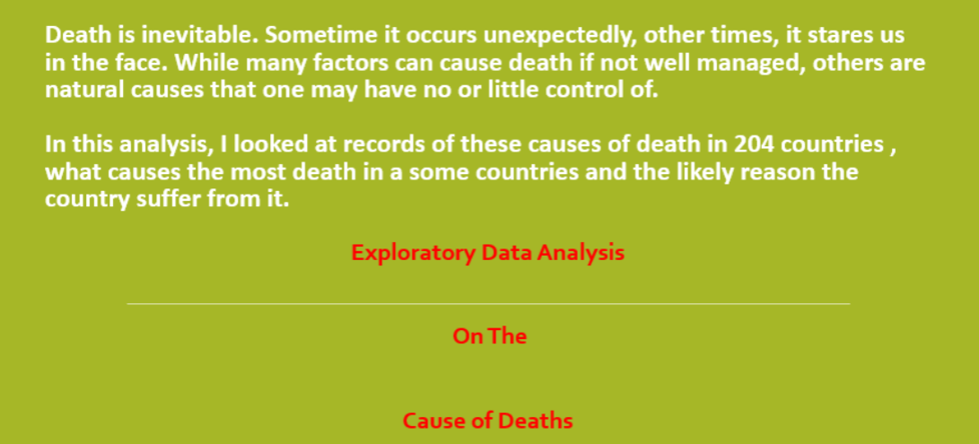

Slide 3
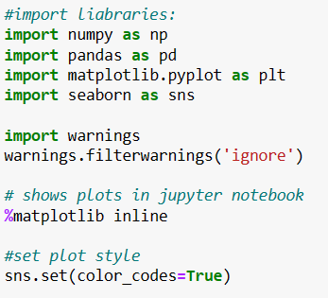
First import all the necessary liabraries

Slide 4
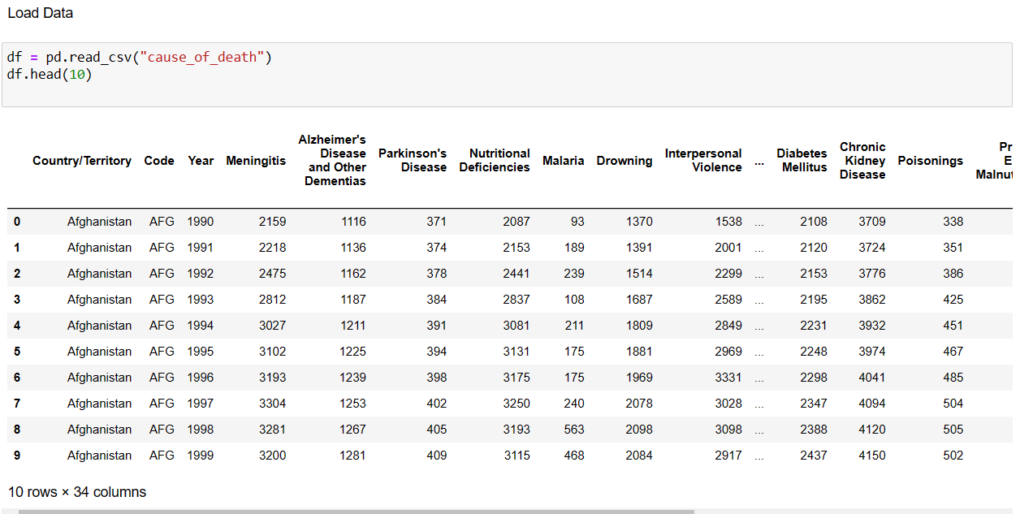
LOAD THE DATA

Slide 5
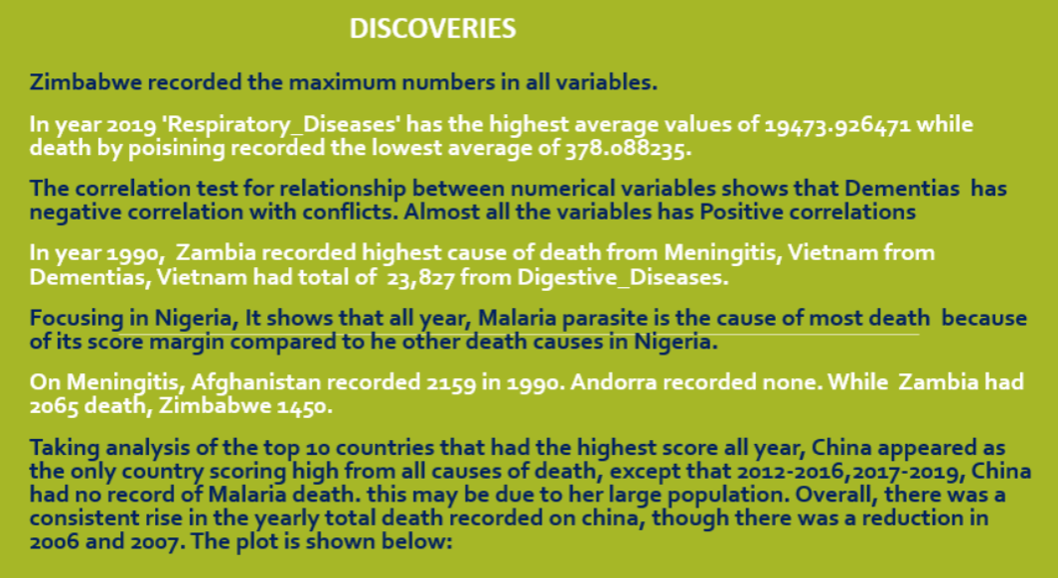

Slide 6
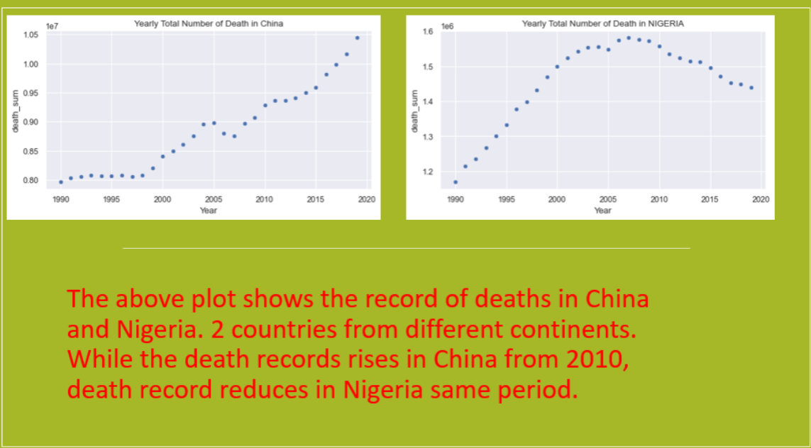

Slide 7
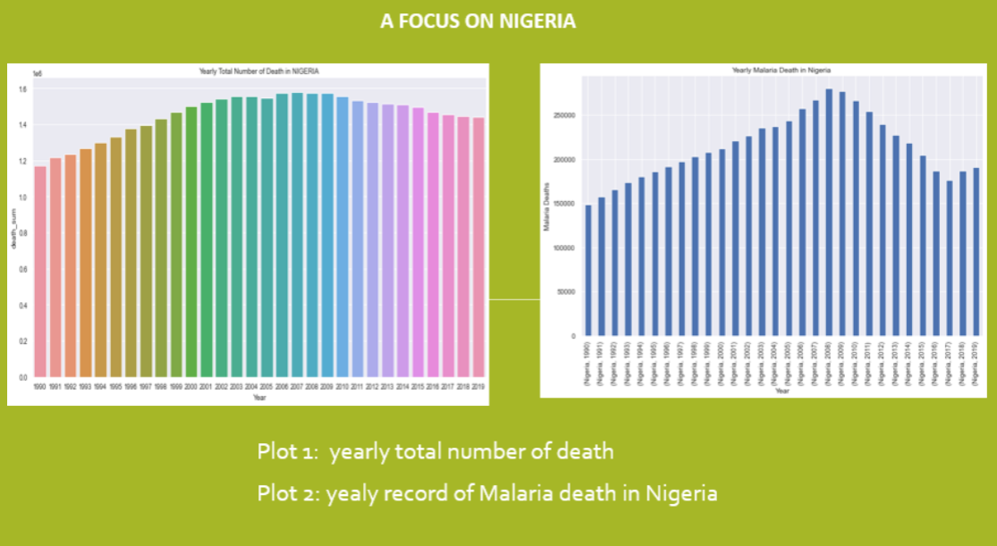

Slide 8
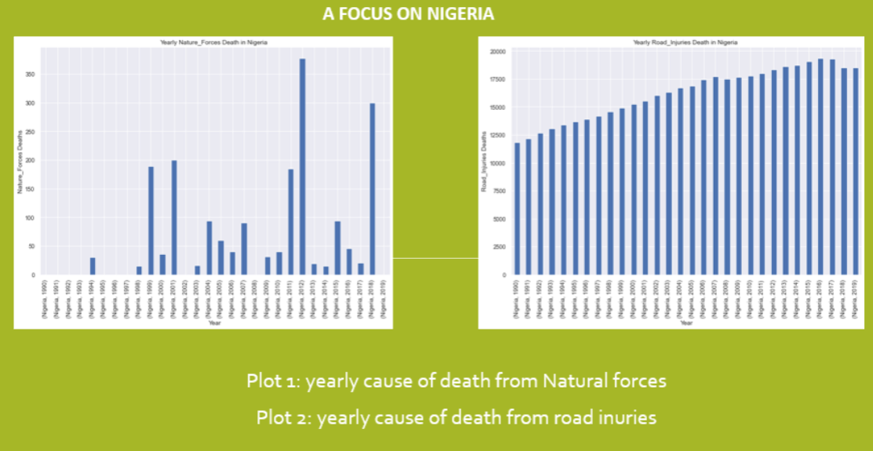

Slide 9
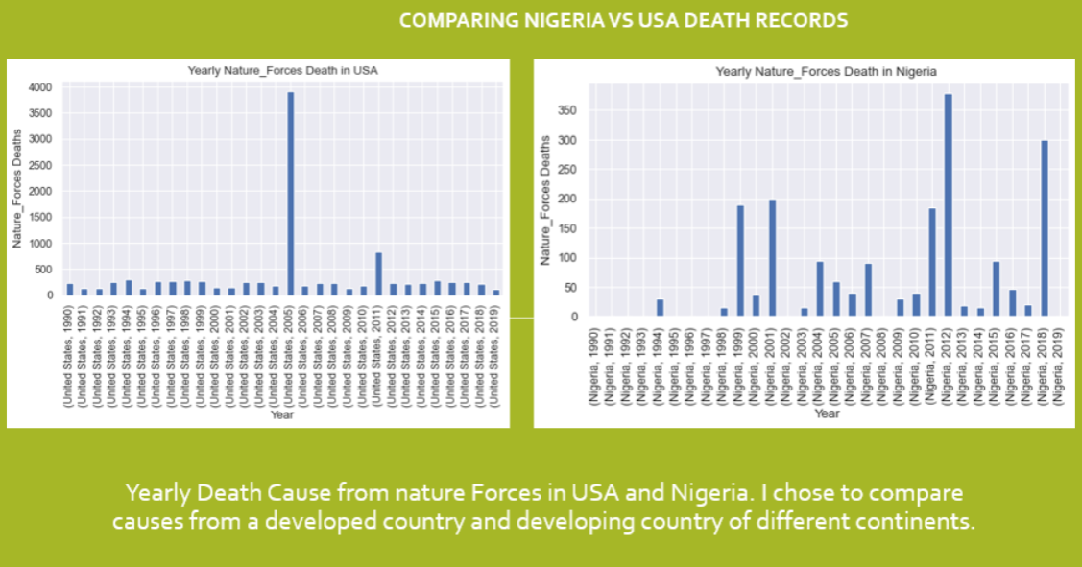

Slide 10
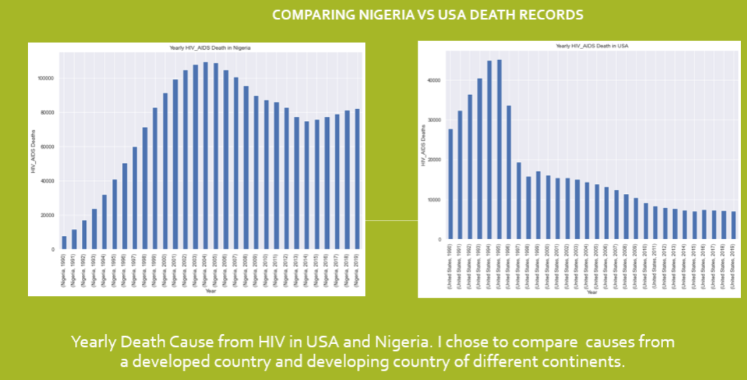

Slide 11

CONCLUSION

Slide 12
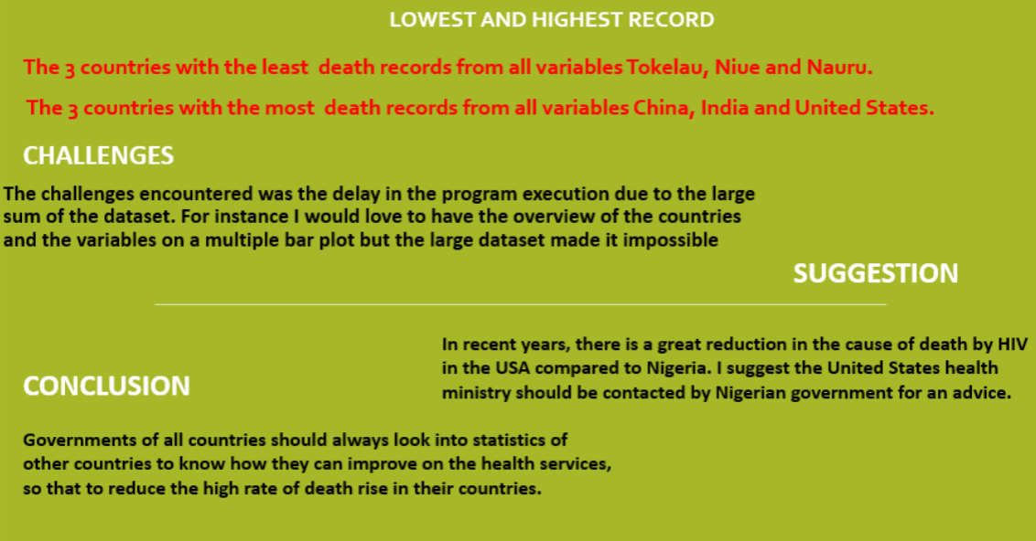

Slide 13
THANK YOU

